Slide 1
Electrical Impedance Tomography
Identifying tumours (or defective regions) in
human body using Machine Learning

Slide 2
Idealogy
Human body has electrical properties
Surface electrodes are attached to the skin around the body part
Small alternating currents will be applied to the electrodes
Impedance is measured across electrodes
Notes:
Impedance: the effective resistance of an electric circuit or component to alternating current, arising from the combined effects of ohmic resistance and reactance.

Slide 3
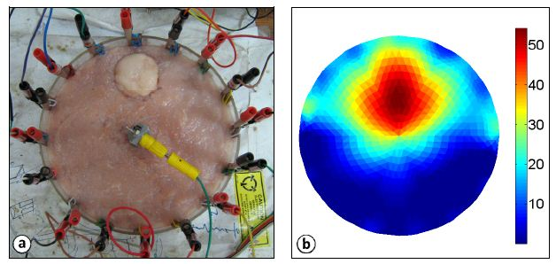
Sample Image of an EIT

Slide 4
Methodology
Sample image is imported using OpenCV and is converted into a 2D Matrix
To simplify the process, it is converted to grayscale
Each value in the matrix represents intensities of either black or white (0 being black and 1 being white)
Impedance is measured across electrodes
Notes:
OpenCV: Open Source Computer Vision Library

Slide 5
Image generation
numpy – random number generator, linspace and meshgrid
1000 random-related images are created based on the matrices and its values
The generated images are read back into code
Images are plotted to observe the distribution of intensities
Notes:
Linespace: Returns evenly spaced numbers over a specified interval.
Returns num evenly spaced samples, calculated over the interval [start, stop].
Meshgrid: Returns coordinate matrices from coordinate vectors.
Make N-D coordinate arrays for vectorized evaluations of N-D scalar/vector fields over N-D grids, given one-dimensional coordinate arrays x1, x2,…, xn.

Slide 6
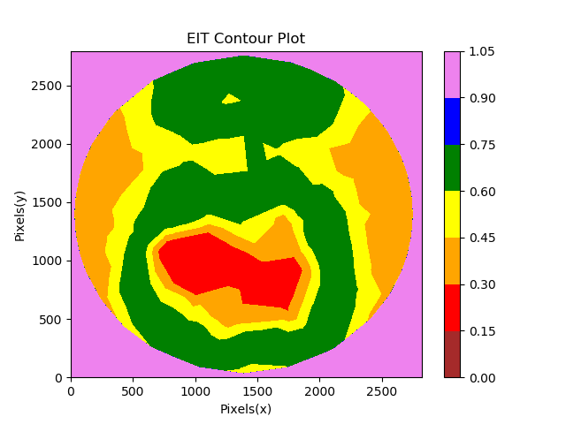
Sample Image Generated
The range of values are assigned colours only for the purpose of representation
Originally, the image is still grayscale
The red region is considered affected

Slide 7
Image generation - Target
Mean intensity ranges are calculated and are assigned labels (colours) correspondingly
A dataset of 8 intensity ranges (columns) and 1000 values (rows) are created
Binary targets are generated and are appended to the existing dataset as a target column
If the pixel count is more than the mean, the image is categorised as ‘1’
If the pixel count is less than the mean, the image is categorised as ‘0’
Notes:
Target: 0 or 1 - Classification

Slide 8
Machine Learning
Data attributes with pixel counts greater than zero are selected as features
Data is split into training and test sets and the model is trained on the training set
Performance of various classification algorithms are measured using cross-validation
Notes:
Cross Validation: Cross-validation is a statistical method used to estimate the skill of machine learning models

Slide 9
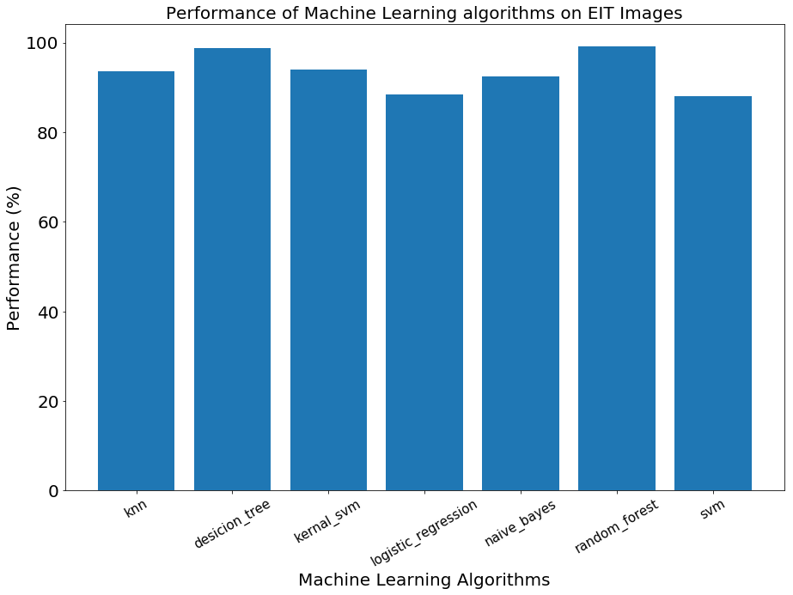
Results
No | Algorithms | Algorithms’ accuracy
1 | K Nearest Neighbours | 93.6%
2 | Decision Tree Classification | 98.8%
3 | Kernel Support Vector Machines | 94%
4 | Logistic Regression | 88.4%
5 | Naive Bayes | 92.4%
6 | Random Forest Classification | 99.2%
7 | Support Vector Machines | 88%

Slide 10
Conclusion
The performance data is collected based on the confusion matrix produced by the algorithms
Decision Tree and Random Forest classifiers performed better than linear classifiers and topped at almost 99%
Similar results can be expected on unseen data.
Notes:
Logistic Regression and SVM showed similar results at 88%. Naïve Bayes, Kernel SVM and K Nearest Neighbours showcased a significant improvement resulting at around 93%. However, Decision Tree and Random Forest classifiers performed better than linear classifiers. Random Forest and Decision Tree both topped at 99% making them the best algorithm to use for this kind of dataset.

